Slide 1
Video presentation

Slide 2
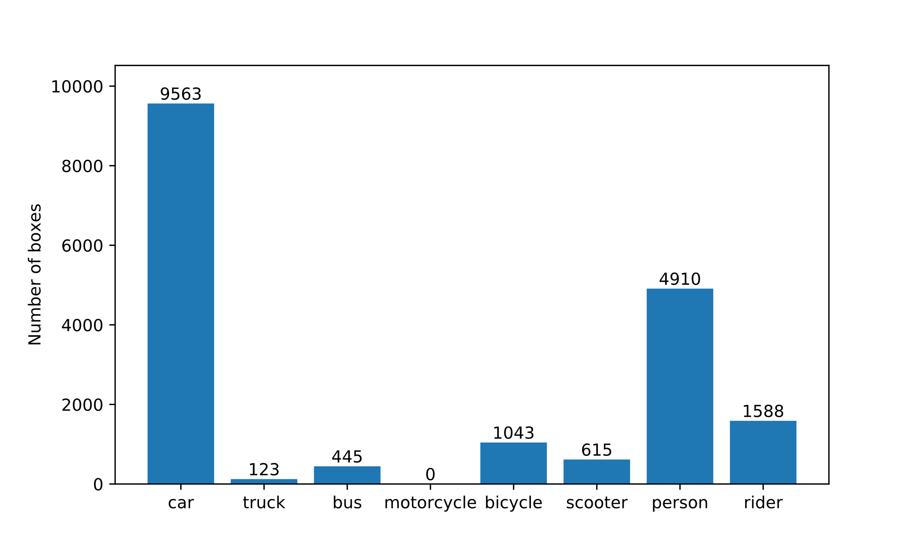
Distribution of boxes per class in dataset

Slide 3
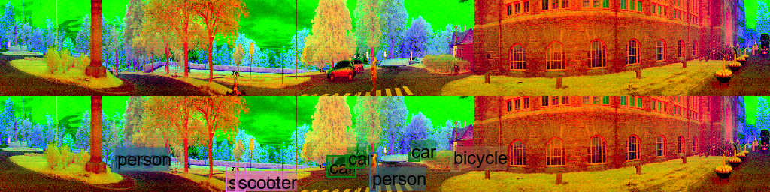
Unlabelled objects

Slide 4
Unlabelled objects

Slide 5
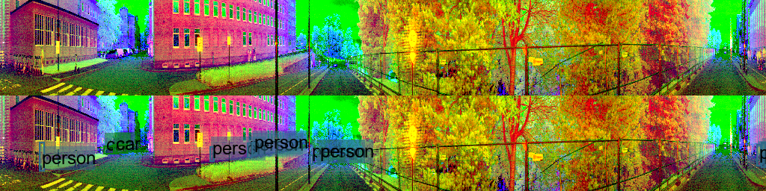
Unlabelled objects

Slide 6
Unlabelled objects

Slide 7
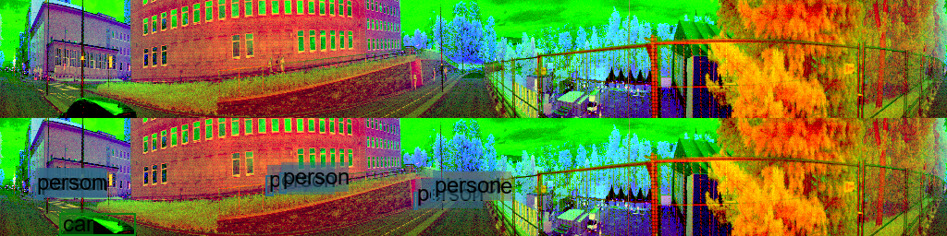
Unlabelled objects

Slide 8
Unlabelled objects
Notes:
Det er lite Trucs i datasettet så denne burde vært lablet

